Slide 1
STAT41130: AI for Weather and Climate
Andrew Parnell

Slide 2
Course Introduction
Quick round table (who are you and why are you here?)
Inspiration for this course:
AI by Hand by Tom Yeh: www.byhand.ai
StatQuest ‘Clearly Explained’ Videos
Artificial Intelligence Forecasting System (AIFS),
Anemoi: https://github.com/ecmwf/anemoi-core
This is a hands-on course, mixing manual calculation and coding.
Weather and climate is a motivating application, but the ideas can be applied more widely.

Slide 3
Github repo
All information at: https://github.com/andrewcparnell/STAT41130
Contains slides (PPT files), code (Python script files), and worksheets.
To access the material either:
Use git directly to download the materials
Go to the website and click: Code -> Download Zip
If you find typos/bugs either:
Let me know (basic)
File an issue on the GitHub page (intermediate)
Create a Pull Request and fix it yourself (advanced, and most helpful)

Slide 4
Setup
Best if you have Ubuntu or similar Linux running on your computer.
Look at the setup folder in the Github repo.
We can go through how to set this up.
Use VS code for coding.
Install the requirements in the requirements_ECMWF.txt file and ensure the set_up.py script runs.

Slide 5
Aims of this course this course
Learn to build and evaluate ML models for weather forecasting for use in your research
01
Understand what the models are doing in the background so that you can extend them
02
Work with real meteorological datasets from e.g. the Climate Data Store
03

Slide 6

Who is this course for?
Designed for students with either AI or weather/climate background
No deep prior experience in either area required
Collaboration across disciplines is strongly encouraged
Lots of interaction and group work
Main expert tools you need are:
$×$and $+$

Slide 7
Structure of course
4 + 4 days:
2 ~1-hour lectures in the morning
1 ~1-hour guided coding class
2-3 hour self-guided coding exercise sheets in the afternoon
Presentations at the end of the day
Computing labs use PyTorch
Lectures start from assuming no knowledge about NNs
Expect to create short presentations, coding tasks, and pen-and-paper exercises

Slide 8
Syllabus (week 1)
Linear regression and neural networks
NNs and back-propagation
Deep learning
Convolutional NNs
Recurrent NNs
Transformers
Graph NNs
Probabilistic forecasting with NNs

Slide 9
Syllabus (week 2)
Overview – data-driven weather forecasting
Effective data loading
Anemoi graphs
Anemoi training
Probabilistic training
Intro to parallel training
Hackathon across Anemoi packages
Anemoi profiling (interactive)

Slide 10
Lecture 1: Linear regression to Neural networks

Slide 11
Learning outcomes
Reminder of linear regression (LR)
How to fit linear regression models
Thinking about LR as a neural network
Fitting LR like a neural network

Slide 12
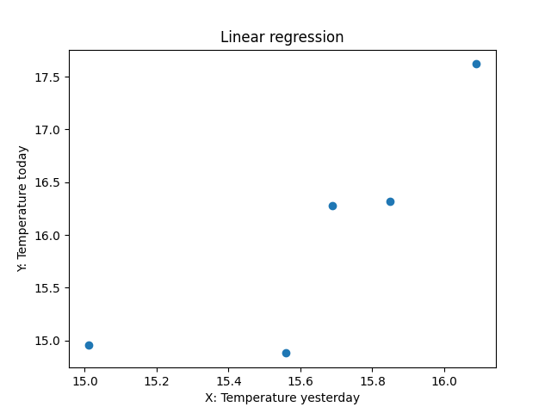
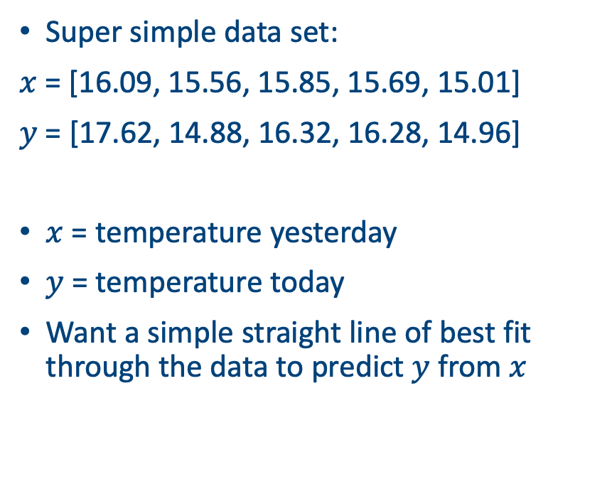
Drawing straight lines of best fit
Super simple data set:
$x$ = [16.09, 15.56, 15.85, 15.69, 15.01]
$y$ = [17.62, 14.88, 16.32, 16.28, 14.96]
$x$ = temperature yesterday
$y$ = temperature today
Want a simple straight line of best fit through the data to predict $y$ from $x$

Slide 13
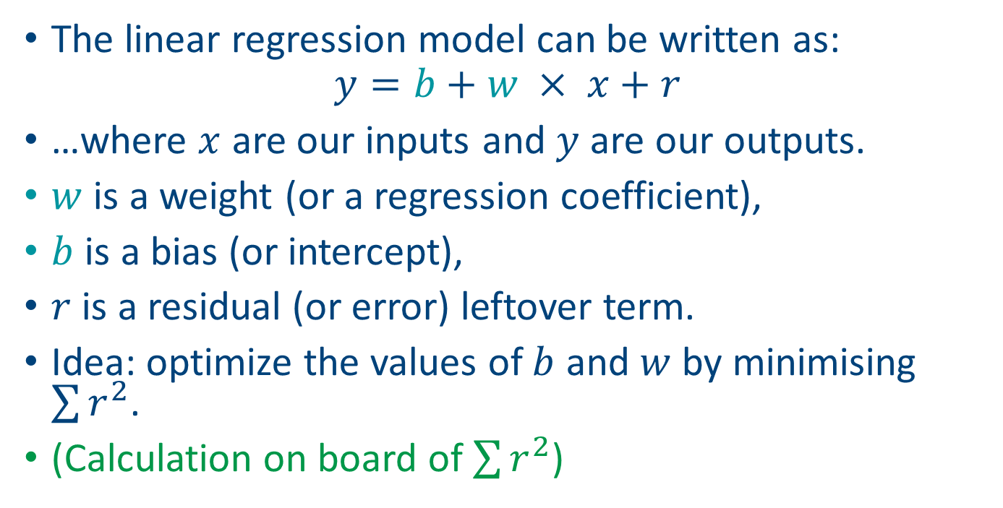
Foundations of linear regression
The linear regression model can be written as:
$$y=b+w × x+r$$
…where $x$ are our inputs and $y$ are our outputs.
$w$ is a weight (or a regression coefficient),
$b$ is a bias (or intercept),
$r$ is a residual (or error) leftover term.
Idea: optimize the values of $b$ and $w$ by minimising $\sum{r^{2}}$.
(Calculation on board of $\sum{r^{2}}$)

Slide 14
Python example
b = 0
w = 0.5
sum_of_squares = np.sum((y - (b + w * X)) ** 2)
print(sum_of_squares)
# Residual sum of squares for b=0, w=0.5: 339.3
b = 1
w = 1
sum_of_squares = np.sum((y - (b + w * X)) ** 2)
print(sum_of_squares)
# Residual sum of squares for b=1, w=1: 4.6

Slide 15
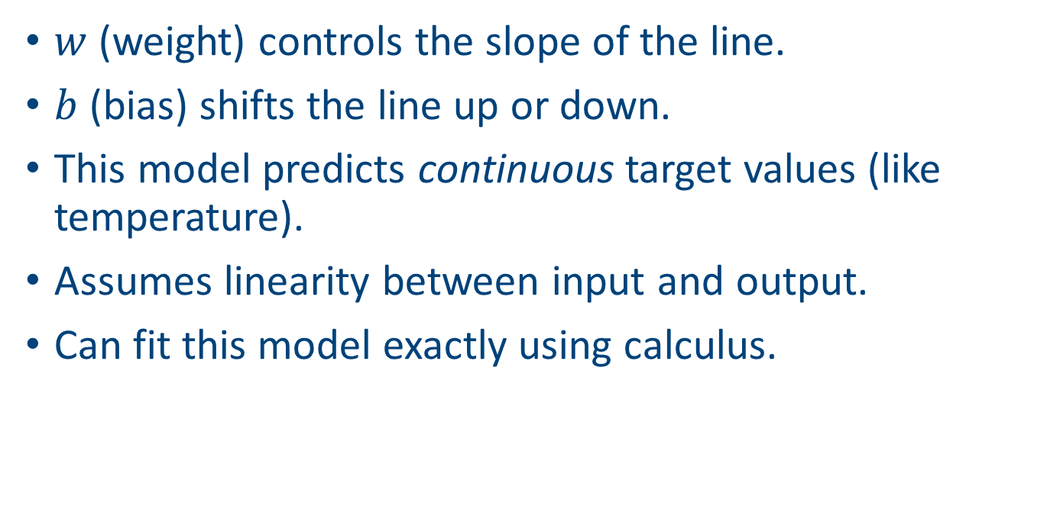
More intuition
$w$ (weight) controls the slope of the line.
$b$ (bias) shifts the line up or down.
This model predicts continuous target values (like temperature).
Assumes linearity between input and output.
Can fit this model exactly using calculus.

Slide 16
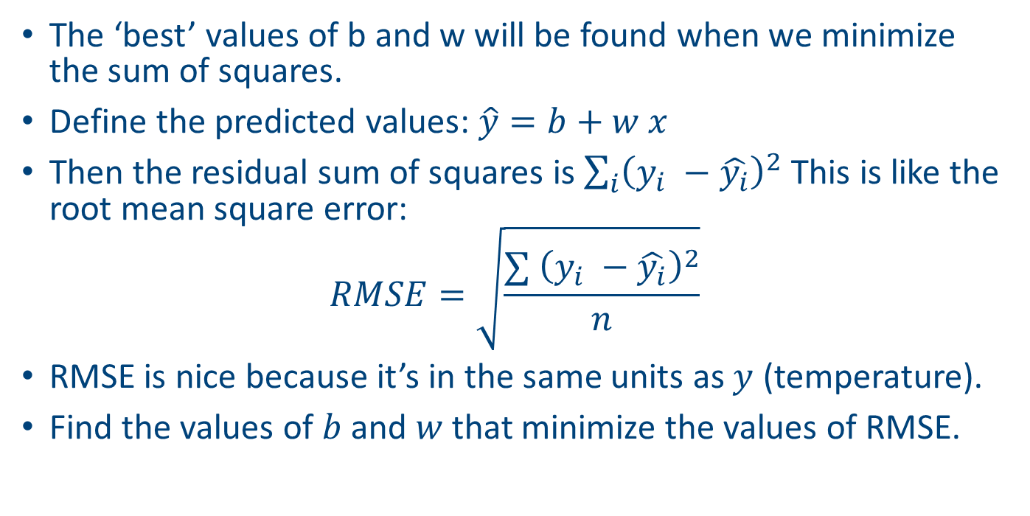
The loss function
The ‘best’ values of b and w will be found when we minimize the sum of squares.
Define the predicted values: $\hat{y}=b+w x$
Then the residual sum of squares is $\sum_{i}{{\left(y_{i} −\hat{y_{i}}\right)}^{2} }$This is like the root mean square error:
$$RMSE=\sqrt{\frac{∑{ \left(y_{i} −\hat{y_{i}}\right)}^{2}}{n}}$$
RMSE is nice because it’s in the same units as $y$ (temperature).
Find the values of $b$ and $w$ that minimize the values of RMSE.

Slide 17
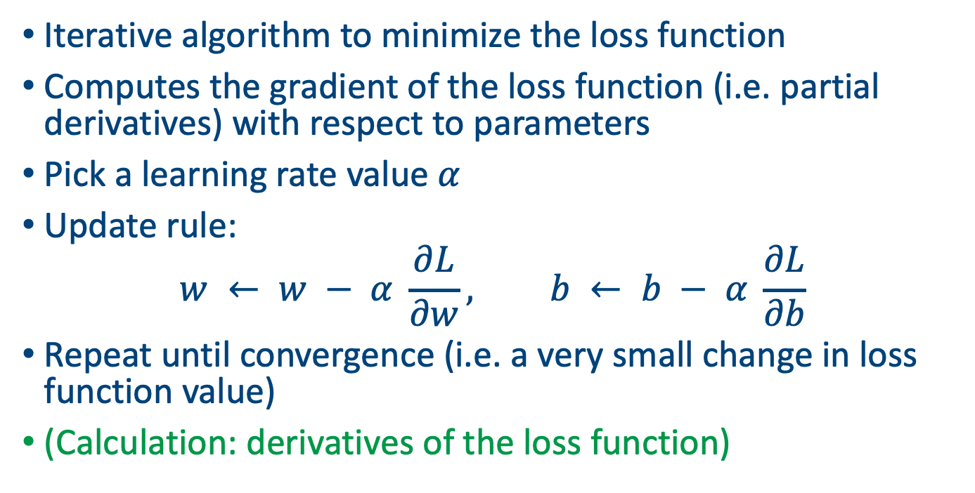
Solution via gradient descent
Iterative algorithm to minimize the loss function
Computes the gradient of the loss function (i.e. partial derivatives) with respect to parameters
Pick a learning rate value $α$
Update rule:
$$w ← w − α \frac{∂L}{∂w}, b ← b − α \frac{∂L}{∂b}$$
Repeat until convergence (i.e. a very small change in loss function value)
(Calculation: derivatives of the loss function)

Slide 18
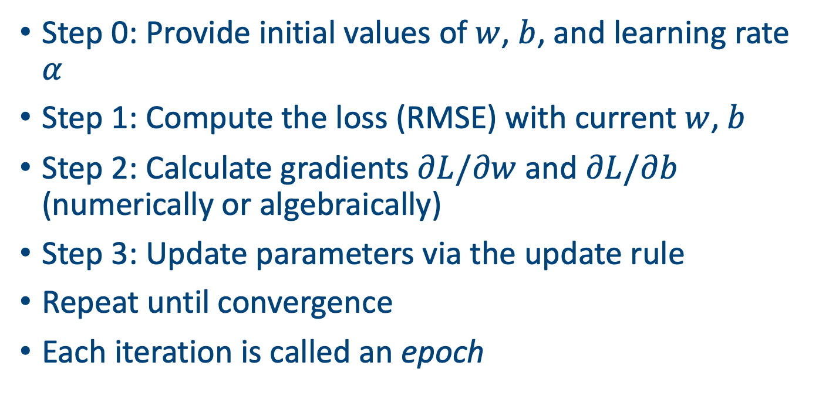
Algorithm
Step 0: Provide initial values of $w$, $b$, and learning rate $α$
Step 1: Compute the loss (RMSE) with current $w$, $b$
Step 2: Calculate gradients $∂L/∂w$and $∂L/∂b$ (numerically or algebraically)
Step 3: Update parameters via the update rule
Repeat until convergence
Each iteration is called an epoch

Slide 19
In action
w, b = 0.0, 0.0
alpha = 0.01
epochs = 100
losses = []
for epoch in range(epochs):
dw, db = compute_gradients(X, y, w, b)
w -= lr * dw
b -= lr * db
loss = rmse(y, predict(X, w, b))
if epoch % 10 == 0:
print(f'Epoch {epoch}, Loss: {loss:.4f}, w: {w:.4f}, b: {b:.4f}')
losses.append(loss)

Slide 20
In action
Epoch 0 | RMSE: 0.945800 | w: 0.998072 | b: 0.999874
Epoch 12 | RMSE: 0.808423 | w: 0.981143 | b: 0.998764
Epoch 24 | RMSE: 0.762661 | w: 0.971897 | b: 0.998145
Epoch 36 | RMSE: 0.748466 | w: 0.966848 | b: 0.997794
Epoch 48 | RMSE: 0.744178 | w: 0.964091 | b: 0.997589
Epoch 60 | RMSE: 0.742894 | w: 0.962586 | b: 0.997464
Epoch 72 | RMSE: 0.742510 | w: 0.961764 | b: 0.997383
Epoch 84 | RMSE: 0.742395 | w: 0.961317 | b: 0.997326
Epoch 96 | RMSE: 0.742360 | w: 0.961073 | b: 0.997282
Epoch 108 | RMSE: 0.742350 | w: 0.960941 | b: 0.997245

Slide 21
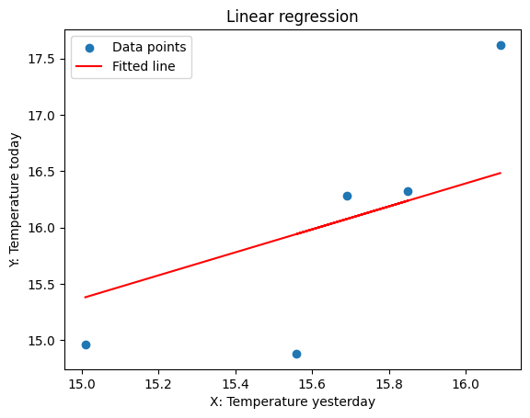
Plotting the fit

Slide 22
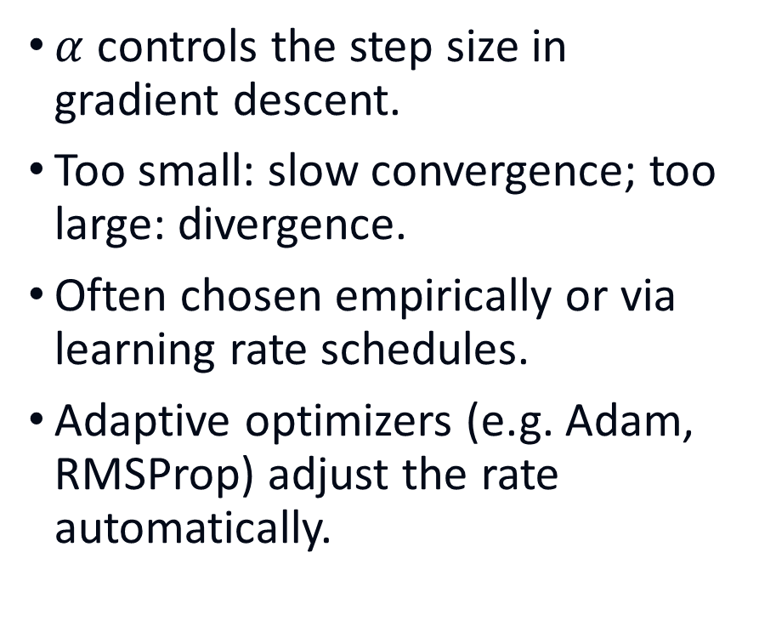
Learning rate
$α$ controls the step size in gradient descent.
Too small: slow convergence; too large: divergence.
Often chosen empirically or via learning rate schedules.
Adaptive optimizers (e.g. Adam, RMSProp) adjust the rate automatically.

Slide 23
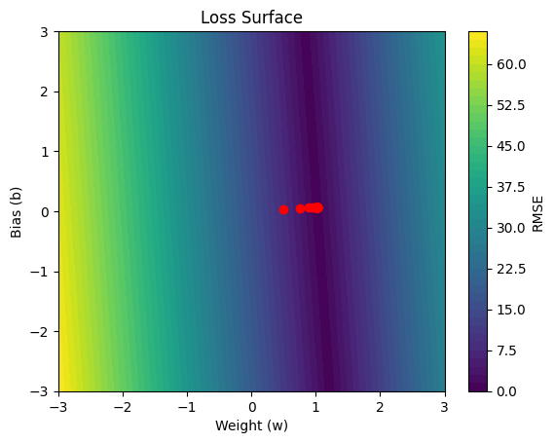
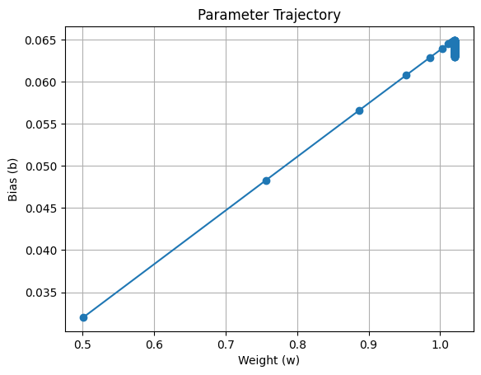
Parameter trajectories

Slide 24
Batch vs stochastic gradient descent
Batch GD: uses entire dataset each iteration; smooth but computationally heavy.
Stochastic GD: updates using fewer (or just one) samples; faster but noisy.
Mini‑batch GD: compromise between the two.
Noise in SGD can help escape shallow minima.

Slide 25
Training and testing
Common to divide up the data set into:
Training set: used to learn the parameters of the model.
Test set: used to evaluate model performance on data the model hasn’t seen.
(Validation set: used to compare different models.)
The majority of the data (e.g. 75%) is used for the training set with the remainder used for validation or testing.
Before deployment, you might want to re-fit your model on all of the data.

Slide 26
Feature Scaling & Normalisation
Inputs on different scales slow down optimisation.
Standardise by removing the mean and scaling to unit variance.
Alternatively scale to [0,1] range (min–max scaling).
Improves numerical stability and convergence.

Slide 27
Other practical tips
Monitor the loss on training and validation sets
Stop model training when validation loss stops improving (early stopping)
Try different learning rates and schedules
Shuffle the data when using stochastic or mini‑batch GD
Use cross‑validation to select hyperparameters (e.g. learning rate)

Slide 28

Next: some extensions
More than one $x$ (feature) variable
Move from regression (continuous $y$) to classification (binary $y$)

Slide 29
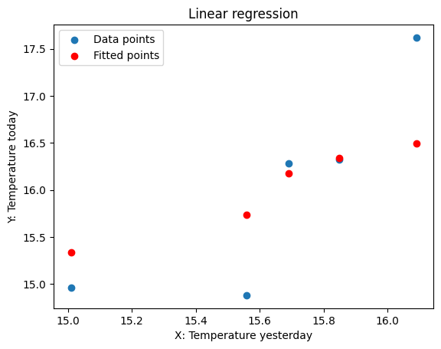
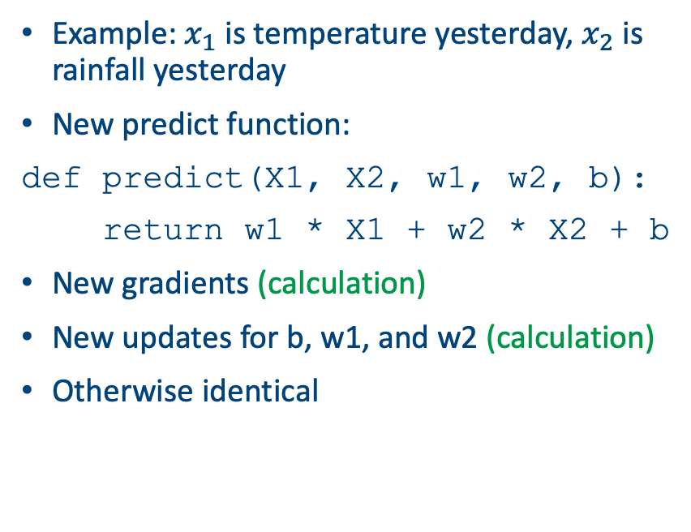
Extension 1: multiple features
Example: $x_{1}$ is temperature yesterday, $x_{2}$ is rainfall yesterday
New predict function:
def predict(X1, X2, w1, w2, b):
return w1 * X1 + w2 * X2 + b
New gradients (calculation)
New updates for b, w1, and w2 (calculation)
Otherwise identical

Slide 30
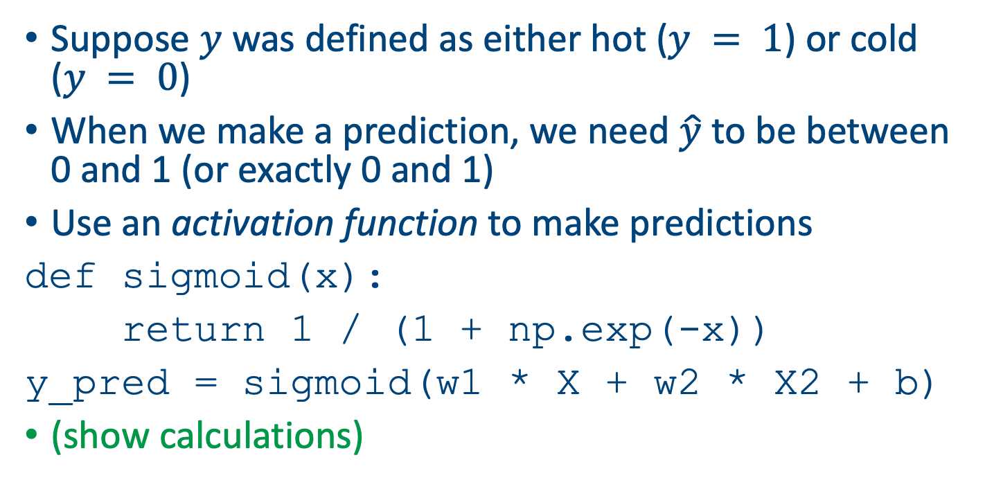
Extension 2: classification
Suppose $y$ was defined as either hot ($y = 1$) or cold ($y = 0$)
When we make a prediction, we need $\hat{y}$ to be between 0 and 1 (or exactly 0 and 1)
Use an activation function to make predictions
def sigmoid(x):
return 1 / (1 + np.exp(-x))
y_pred = sigmoid(w1 * X + w2 * X2 + b)
(show calculations)

Slide 31
New loss function
def binary_cross_entropy(y_true, y_pred):
epsilon = 1e-15
y_pred = np.clip(y_pred, epsilon, 1 - epsilon)
return -np.mean(y_true * np.log(y_pred) + (1 - y_true) * np.log(1 - y_pred))
The clipping and the epsilon avoid us from creating log(0)
When y_true = 1 it’s just the log of the prediction, and when y_true = 0 it’s the log of 1 minus the prediction
Averaged over all the data points

Slide 32
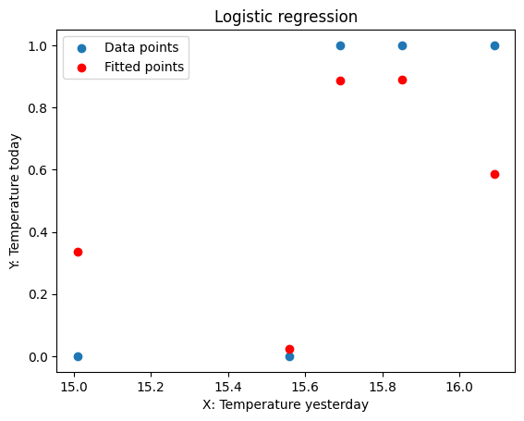
Results
Epoch 0, Loss: 0.6931, w1: 0.0013, w2: -0.0127, b: -0.0001
Epoch 10, Loss: 0.6091, w1: 0.0146, w2: -0.1398, b: -0.0014
Epoch 20, Loss: 0.5366, w1: 0.0279, w2: -0.2670, b: -0.0026
Epoch 30, Loss: 0.4747, w1: 0.0412, w2: -0.3941, b: -0.0038
Epoch 40, Loss: 0.4223, w1: 0.0545, w2: -0.5212, b: -0.0051
Epoch 50, Loss: 0.3782, w1: 0.0678, w2: -0.6483, b: -0.0063
Epoch 60, Loss: 0.3409, w1: 0.0810, w2: -0.7755, b: -0.0075
Epoch 70, Loss: 0.3094, w1: 0.0943, w2: -0.9026, b: -0.0088
Epoch 80, Loss: 0.2826, w1: 0.1076, w2: -1.0297, b: -0.0100
Epoch 90, Loss: 0.2597, w1: 0.1209, w2: -1.1568, b: -0.0112

Slide 33
Summary
Key ingredients: loss function, prediction function, gradients.
Loop through using gradient descent to optimise the weights and the biases.
Run over epochs until the parameters converge.
Use the final values as your final model to predict.
All code available to re-create these plots in the Github repository.

